Slide 1
Start

Slide 14


Wynand
Isham
Ahmed
Kome
Your Car’s personal Fitness-Tracker
December 1st 2018 University of Manitoba

Slide 15
The Idea Behind Our App
Problems We Faced on this Dangerous Journey
Your Car’s personal Fitness-Tracker
Implementation
December 1st 2018 University of Manitoba
How we tested it

Slide 16
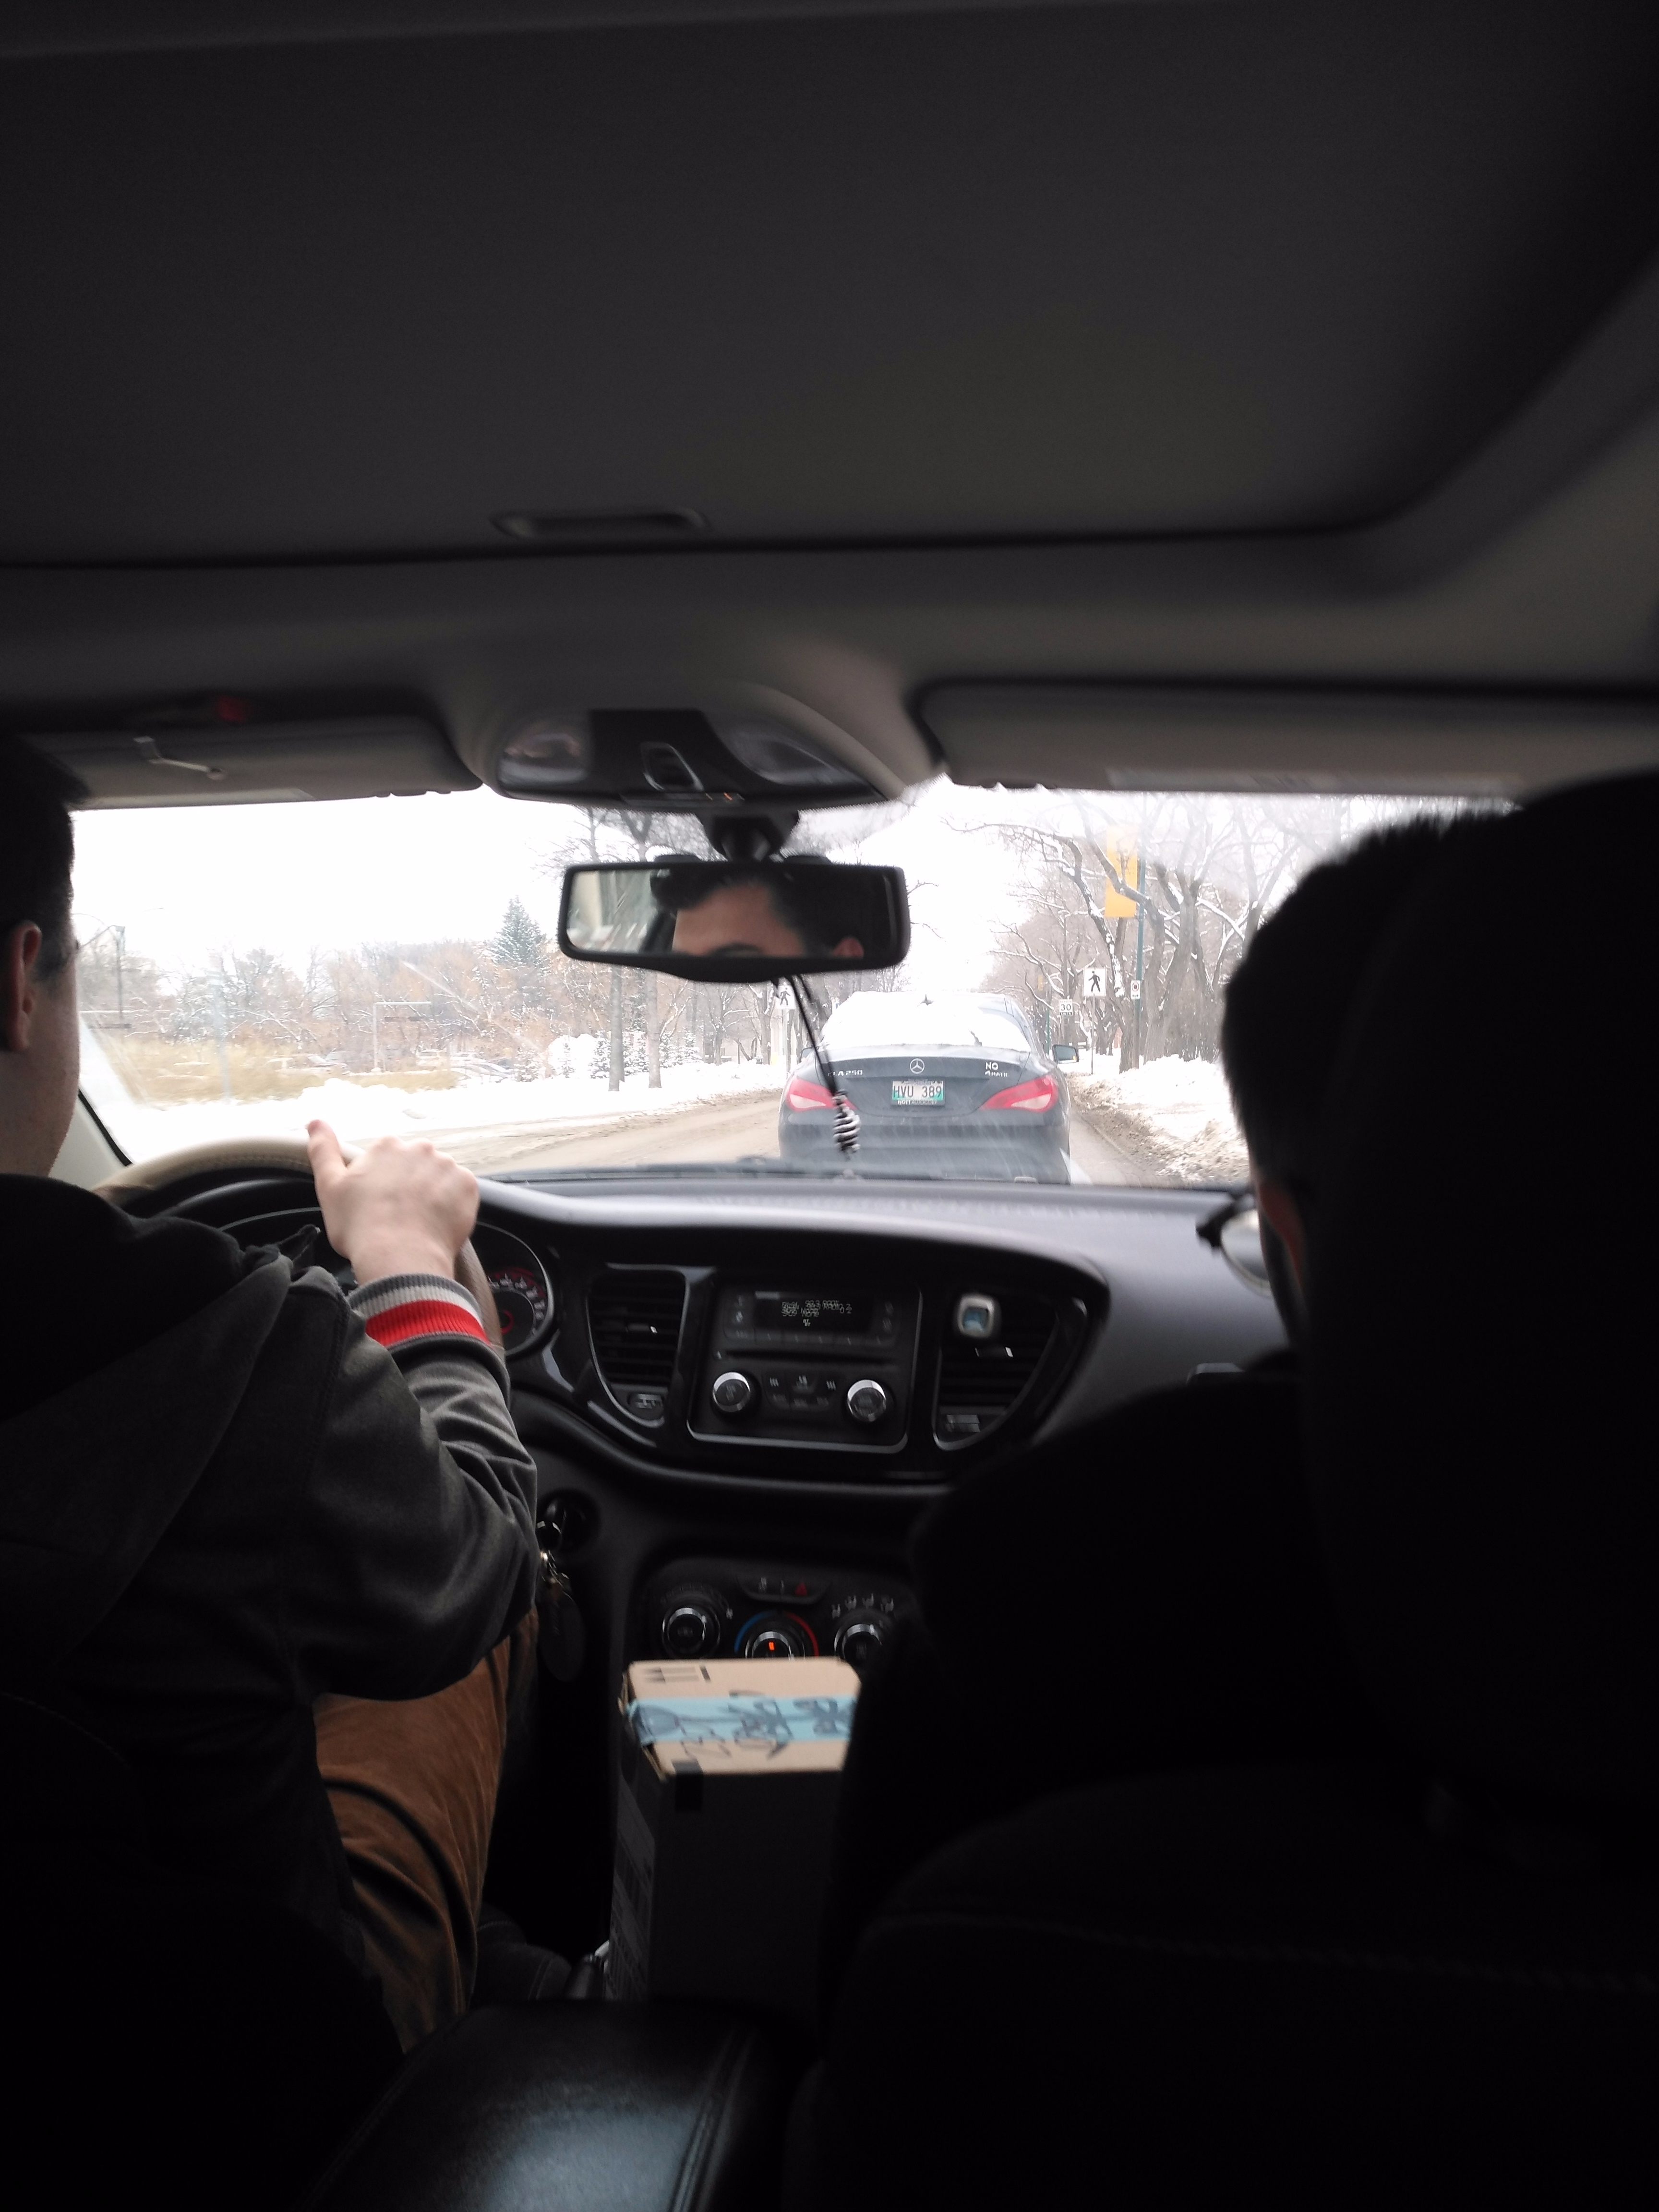
Your Car’s personal Fitness-Tracker
December 1st 2018 University of Manitoba

Slide 17
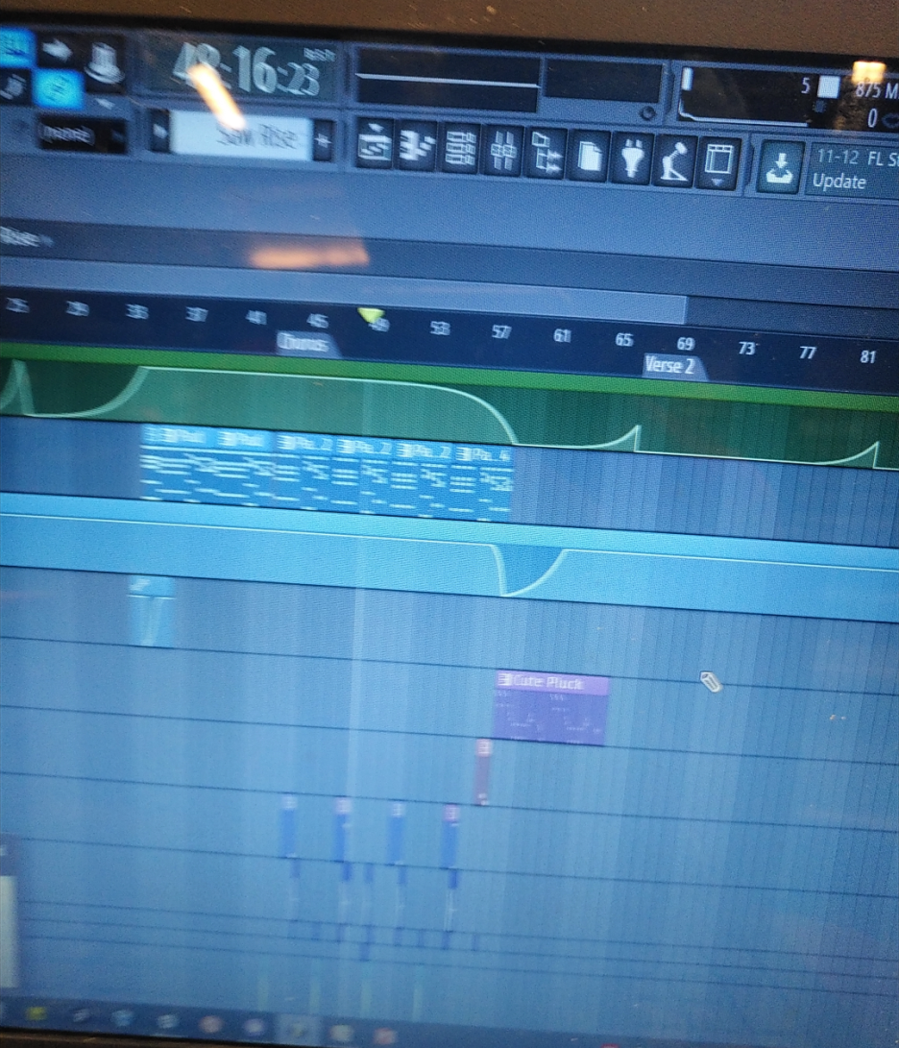
Your Car’s personal Fitness-Tracker
December 1st 2018 University of Manitoba

Slide 18
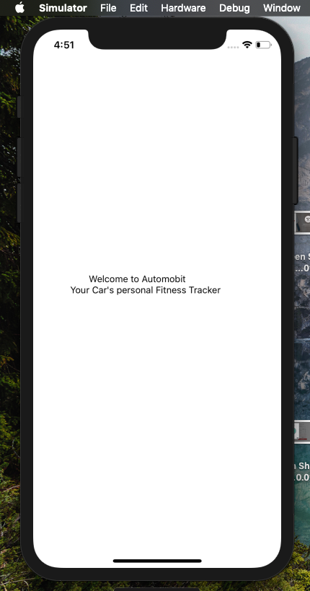
Your Car’s personal Fitness-Tracker
December 1st 2018 University of Manitoba

Slide 19
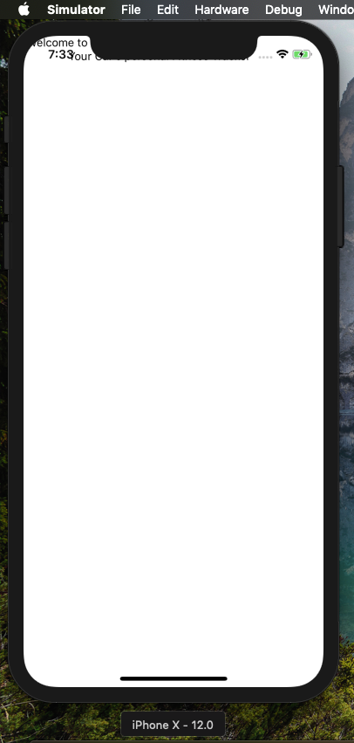
Your Car’s personal Fitness-Tracker
December 1st 2018 University of Manitoba

Slide 20
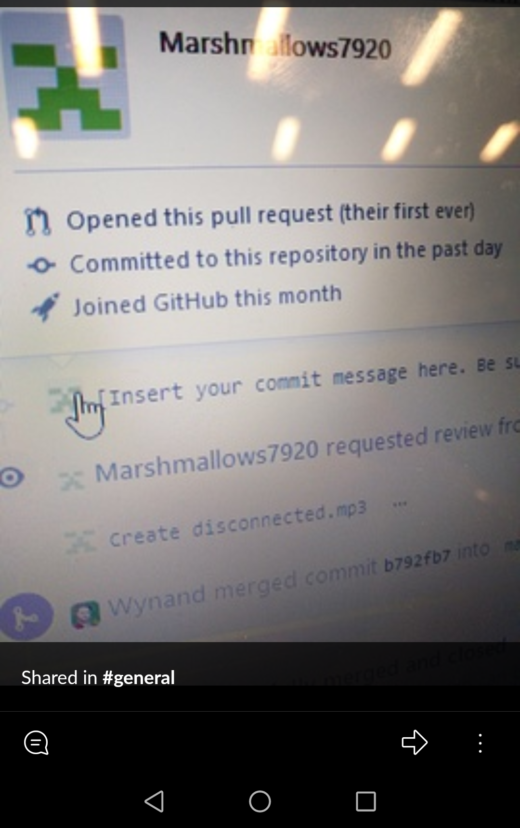
Your Car’s personal Fitness-Tracker
December 1st 2018 University of Manitoba

Slide 21
Demo Time
(Prototype)
Your Car’s personal Fitness-Tracker
Start Demo
December 1st 2018 University of Manitoba

Slide 22


Slide 23


Slide 24


END

Slide 25






94^{km/h}
Speed score:
34%

Slide 26
Fuel Left:
34 L
236 km
~4 days
Wiper Washer 54%
Coolant 10%
Next Oil Change
~ 2 weeks

Slide 27
Driving score: 5546
Global rank:
Top 20,000
Tip:
Try slowing down on
turns

Slide 28
No Engine Problems
☺

Slide 29
Your Battery needs
to be replaced in 2
years
Current Battery Health: 37%
Outside Temp: -30ºC
Batteries work best above 0ºC

Slide 30
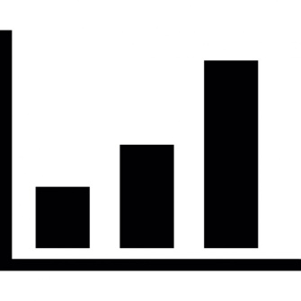

You’re a broke student You don’t need this
View Fuel Prices
Wallet

Slide 31
Thank You

